Slide 1

CSE428 Presentation
Human Action Recognition With CNN By Following
Object Detection and Background Extraction
Submitted By:
Name: Murad Hasan
ID: 18301253
Section: 01

Slide 2
Motivation
HAR is a significant challenge for various reason
Usage of cameras has expanded
Identify any kind of crime or violence

Slide 3
Problem Statement
Less accuracy in few classes (Biking,Swing,Walking with Dog )
Because of same background elements
Low input resolution

Slide 4


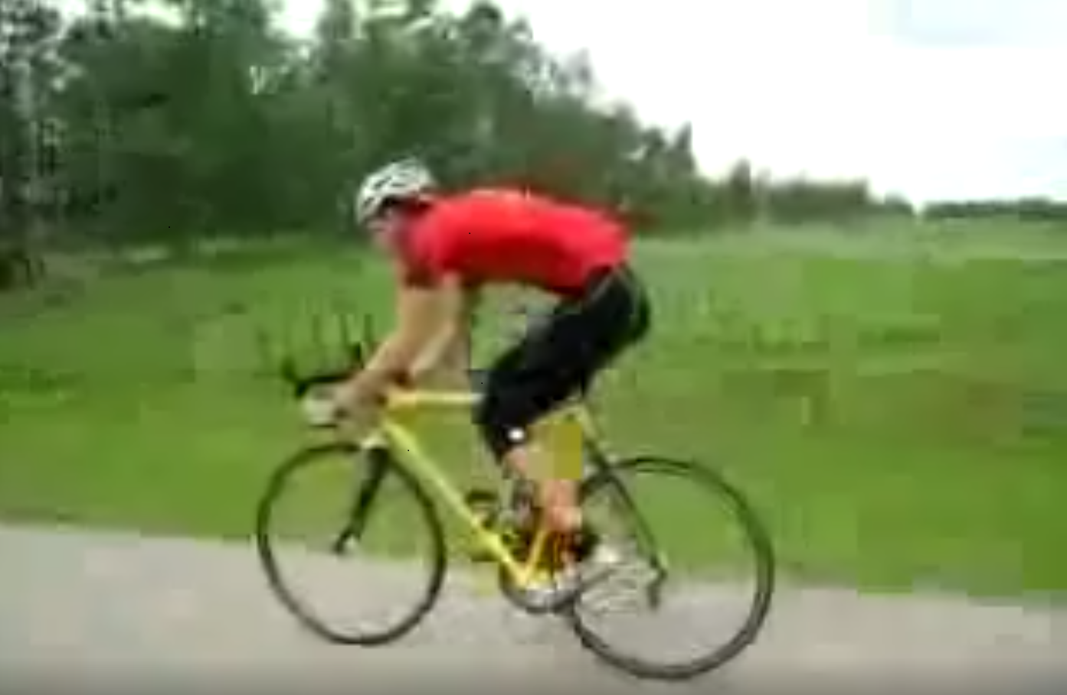
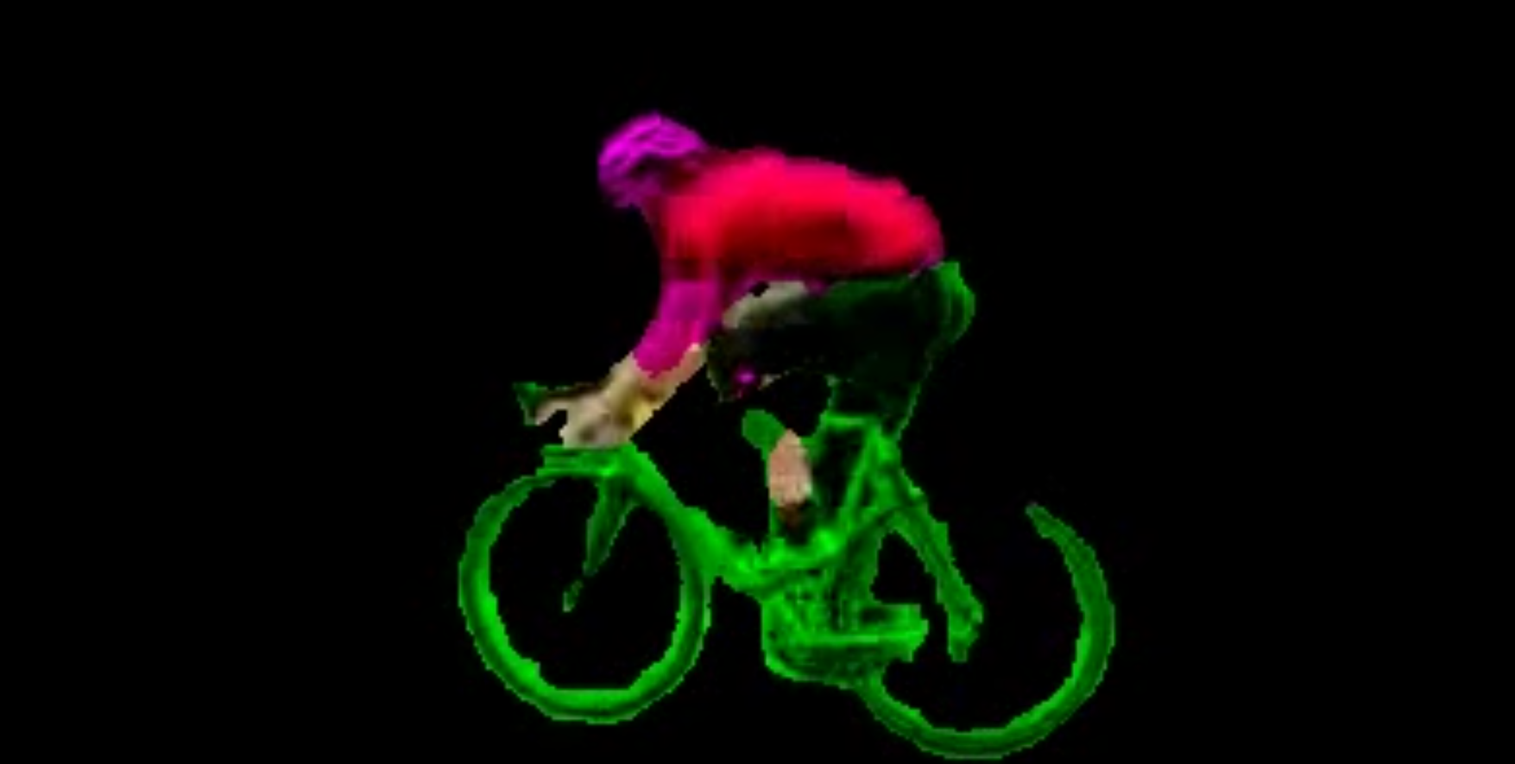
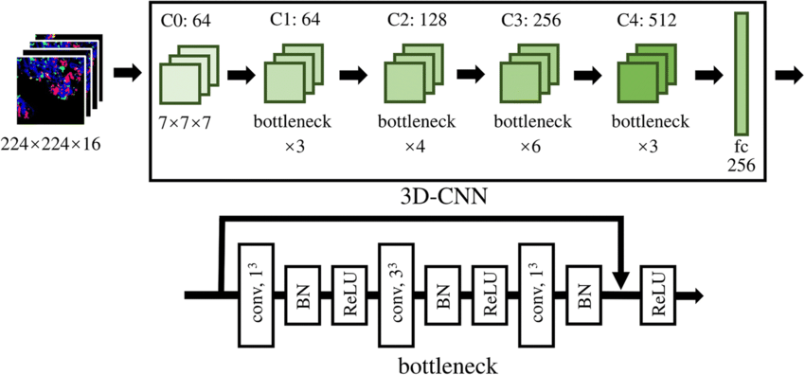
Methodology
Background subtraction by MaskRCNN
Extracting Frames
Training the frames in ResNet CNN
Background subtraction
ResNet Model

Slide 5
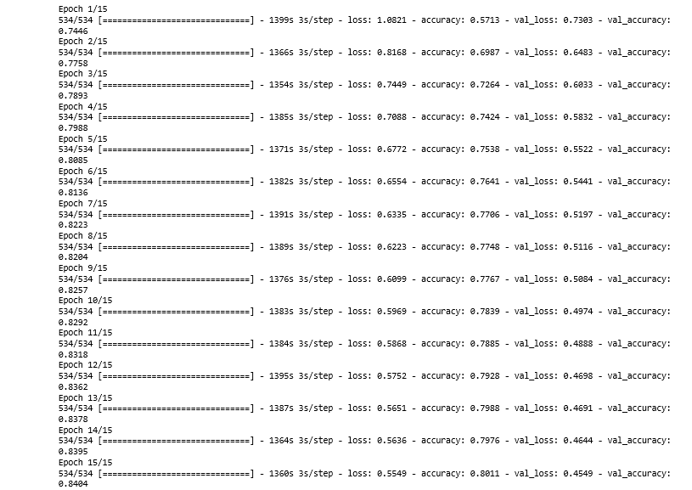
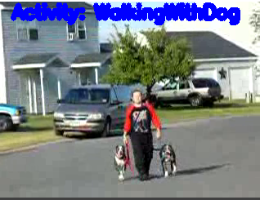
Results & Discussion
80% Training Testing Accuracy
More Than 90% accuracy in new videos
Background element was the issue
Training Testing Accuracy
Result

Slide 6
Conclusion & Possible Improvements
Same approach can be implemented in various video classification problem
Custom Object Detection needed
CNN+LSTM Model can be implemented further
Pose estimation values can be added in the model

Slide 7
Links & References
https://github.com/hasanmurad4919/Human-Action-Recognition-With-CNN-By-Following-Object-Detection-and-Background-Extraction
T. Lima, B. Fernandes and P. Barros, "Human action recognition with 3D convolutional neural network," 2017 IEEE Latin American Conference on Computational Intelligence (LA-CCI),2017, pp. 1-6, doi: 10.1109/LA-CCI.2017.8285700.

